Slide 1
TaskMan
A Project-Oriented Task Manager
SWOP – Iteration 1

Slide 2
Overview of the design
UI
Controller
Clock
Project
Task
User
XmlObject
Status
UserType

Slide 3
The Task class
Information Expert
Don’t Talk to Strangers
Mocking
Julien Benaouda, Jeroen Van Der Donckt & Alexander Braekevelt

Slide 4
The Project class
Information Expert
Creator: verkeerd!
Indirection
Don’t Talk to Strangers
Julien Benaouda, Jeroen Van Der Donckt & Alexander Braekevelt

Slide 5
The Clock class
Information Expert
Don’t Talk to Strangers
Julien Benaouda, Jeroen Van Der Donckt & Alexander Braekevelt

Slide 6
The User class
static class
Information Expert
Indirection
Don’t Talk to Strangers
Julien Benaouda, Jeroen Van Der Donckt & Alexander Braekevelt

Slide 7
The Controller class
Controller
Creator
Indirection
Julien Benaouda, Jeroen Van Der Donckt & Alexander Braekevelt

Slide 8
The XmlObject class
Pure fabrication
Information expert
Julien Benaouda, Jeroen Van Der Donckt & Alexander Braekevelt

Slide 9
The UI class
Information Expert
Don’t Talk to Strangers
Forms
Mocking for print & input
Julien Benaouda, Jeroen Van Der Donckt & Alexander Braekevelt

Slide 10
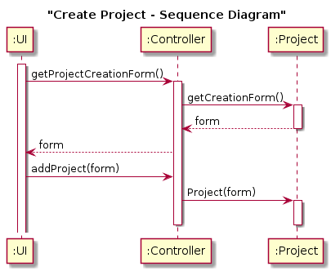
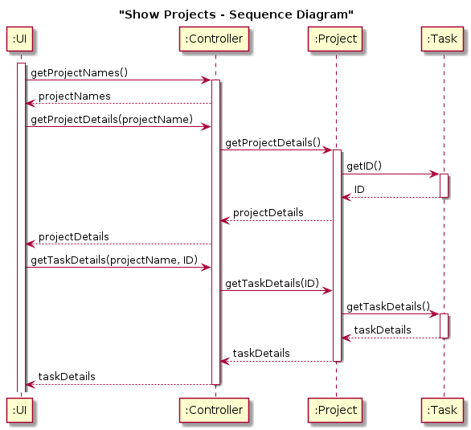
Use cases

Slide 11
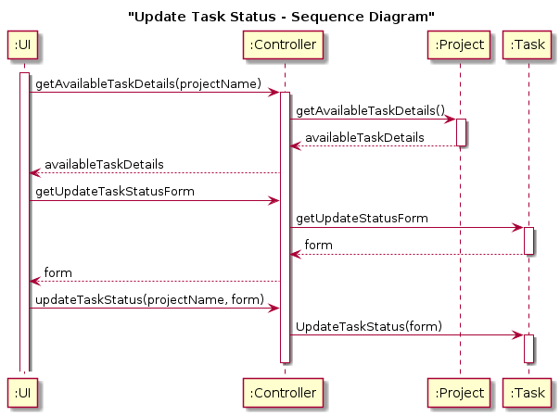
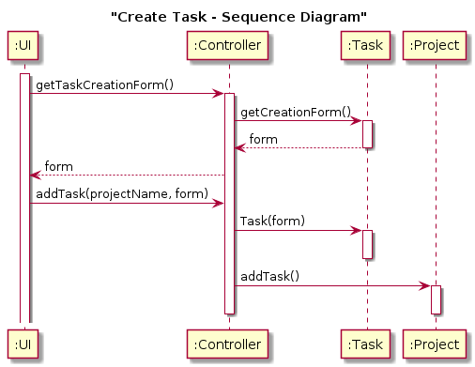
Use cases

Slide 12
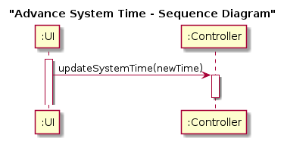
Use cases

